Slide 1

The Battle of Neighborhoods - Where to start a Sushi restaurant in Calgary, Alberta ?
By David jianzhe li

Slide 2
Agenda
Introduction
Data and EDA
K-means Clustering
Recommendations
Future consideratons

Slide 3
INTRO
Calgary is a city in the western Canadian province of Alberta, Canada
80 km east of the Canadian Rockies.
Biggest city in Alberta and the second largest in western Canada after only Vancouver
BUSINESS PROBLEM:
Where to start a Sushi restaurant in Calgary, Canada?

Slide 4
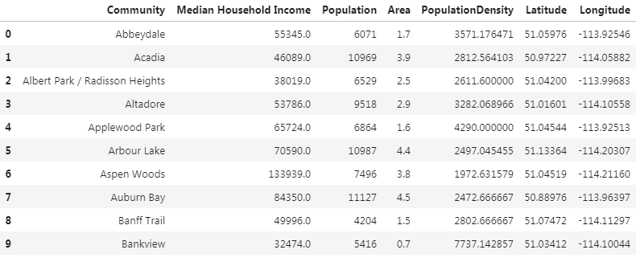
Data sources
Neighborhood and area -Wiki
Neighborhood demographics – great-news.ca
Geo data from Geocoder

Slide 5
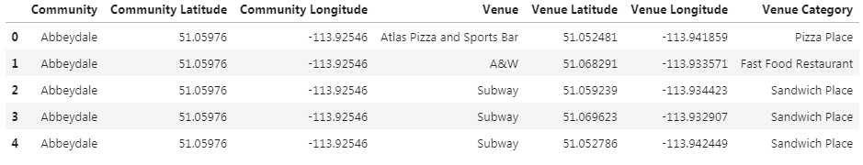
Venue data from Foursquare API - food Section ONLY
https://api.foursquare.com/v2/venues/explore?&client_id={}&client_secret={}&v={}&ll={},{}&radius={}&section={}&limit={}'.format(
CLIENT_ID,
CLIENT_SECRET,
VERSION,
lat,
lng,
radius,
SECTION,
LIMIT)

Slide 6
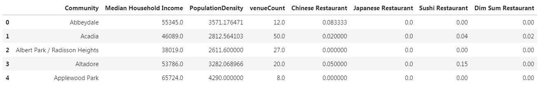
Feature Extraction

Slide 7
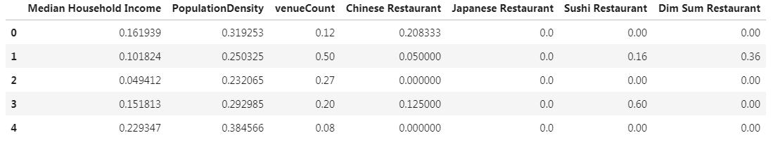
Data normalization – max/min scaler
featureDF_scaled = featureDF - featureDF.min()
featureDF.max() - featureDF.min()

Slide 8
Find k with Elbow method – K-means clustering
k: Optimal number of clusters
Distortion: average of the squared distances from the cluster centers of the respective clusters.
Inertia: sum of squared distances of samples to their closest cluster center.

Slide 9
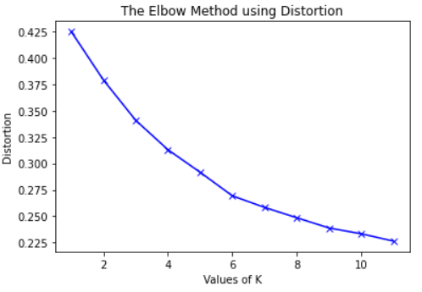
Elbow method using Distortion( k = 5 )

Slide 10
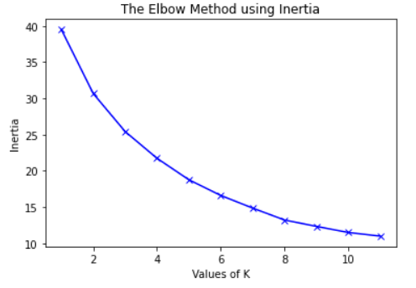
Elbow method using Inertia( k = 5 )

Slide 11
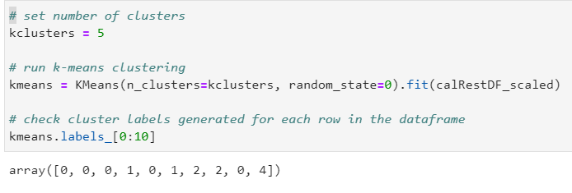
K-means clustering (k = 5)

Slide 12
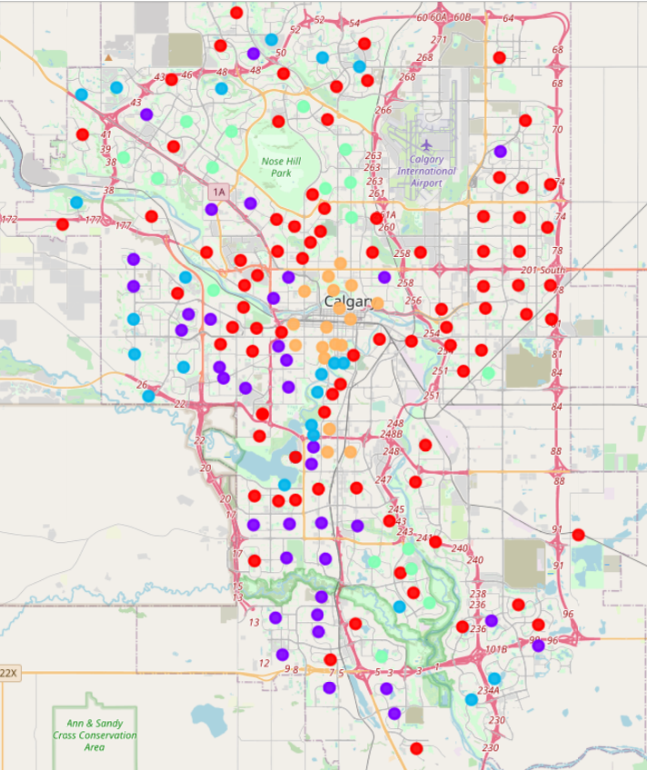
Clustering on the map

Slide 13
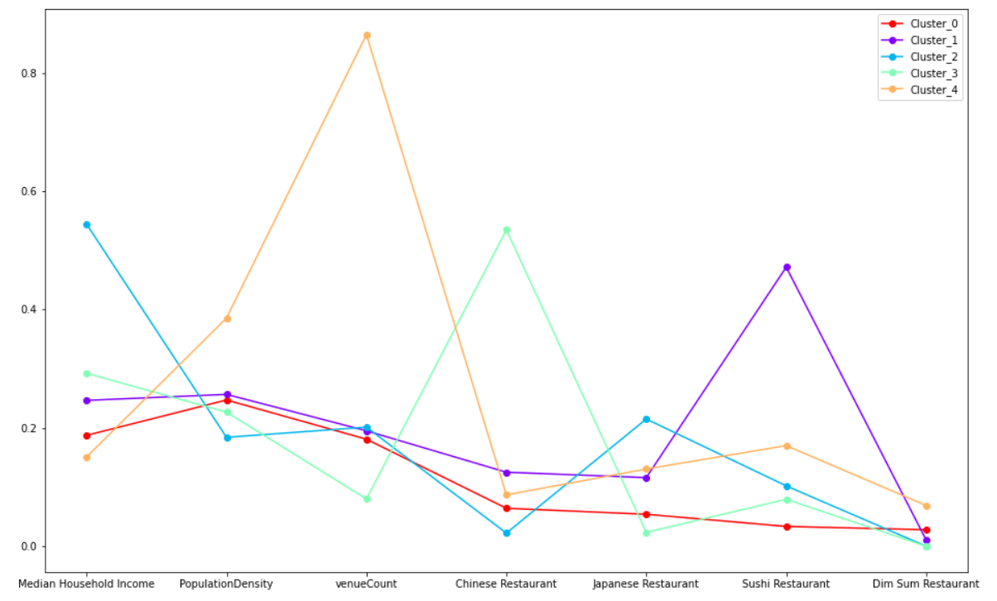
Clustering line graph

Slide 14
Clustering analysis
Cluster 0: Lower family income, medium population density, fair overall food venue coverage and low East Asian restaurant coverage.
Cluster 1: Medium family income, medium population density, medium overall food venue coverage with fair Chinese/Japanese restaurant coverage, but highest Sushi restaurant coverage.
Cluster 2: Highest family income, lowest population density and fair overall food venue coverage, highest Japan restaurant coverage, but low Sushi restaurant coverage.
Cluster 3: High family income, lower density and lowest overall food venue coverage, highest Chinese restaurant coverage, but low Sushi restaurant coverage
Cluster 4: Lowest family income, highest population density and overall food venue coverage, high East Asian restaurant coverage.

Slide 15
Recommendations
Cluster 0: Not recommended even if a low East Asian restaurant coverage, due to its low family income, fair overall food venue coverage.
Cluster 1: Not recommended due to its highest Sushi restaurant coverage (fierce competition), medium population density, and medium family income.
Cluster 2: Highly recommended for a high-end Sushi restaurant. Highest family income, low Sushi restaurant coverage. Some competition from Japanese restaurants.
Cluster 3: Highly recommended for a high-end Sushi restaurant. High family income, low Sushi restaurant coverage. Some competition from Chinese restaurants.
Cluster 4: Highly recommended for low-end fast-food like Sushi restaurant. Lowest family income, highest population density and overall food venue coverage. Downtown or hub areas.

Slide 16
Future considerations – ways to improve
Improved Foursquare data
More neighborhood data, such as:
median rent, median age, proximity to C-train line, and etc.
Try other clustering algorithm, Hierarchical clustering, and compare performance

Slide 17
Thank you

